Slide 1
Lecture Presentation - 2
Chapter 4: Ohm’s Law, Power and Energy
Abu Ahmed Ferdaus, CSE, DU.

Slide 2
This lecture includes:
Ohm’s Law
Power
Wattmeter
Energy
Circuit Breaker and Fuses
Abu Ahmed Ferdaus, CSE, DU.

Slide 3

4.1 Ohm’s Law
Every conversion of energy from one form to another can be related to the above equation.
In electric circuits, the effect is the flow of charge, or current. The potential difference, or voltage, between two points is the cause (“pressure”), and the opposition is the resistance encountered.
Abu Ahmed Ferdaus, CSE, DU.

Slide 4
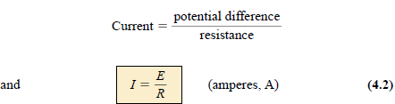
4.1 Ohm’s Law
The following equation is known as Ohm’s Law in honour of Georg Simon Ohm
For a fixed resistance, the greater the voltage (or pressure) across a resistor, the more the current, and the more the resistance for the same voltage, the less the current.
In other words, the current is proportional to the applied voltage and inversely proportional to the resistance.
Abu Ahmed Ferdaus, CSE, DU.

Slide 5

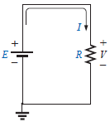
4.1 Ohm’s Law
The voltage and resistance can be found in terms of the other two quantities:
The three quantities of Eqs. (4.2) through (4.4) are defined by the simple circuit:
Note:
the symbol E is applied to all sources of voltage
the symbol V is applied to all voltage drops
across components of the network.
Abu Ahmed Ferdaus, CSE, DU.

Slide 6
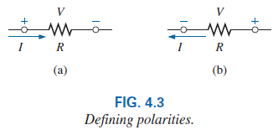

4.1 Ohm’s Law
Since the battery in Fig. 4.2 is connected directly across the resistor, the voltage V_{R} across the resistor must be equal to that of the supply. Applying Ohm’s law:
The voltage source “pressures” current (conventional current) in a direction that leaves the positive terminal of the supply and returns to the negative terminal of the battery (for single-source networks).
Note also that the current enters the positive terminal and leaves the negative terminal for the load resistor R.
For any resistor, in any network, the direction of current through a resistor will define the polarity of the voltage drop across the resistor.
Abu Ahmed Ferdaus, CSE, DU.

Slide 7
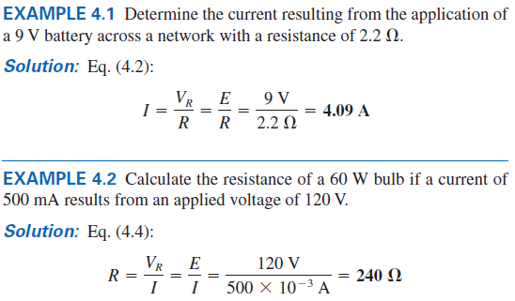
4.1 Example 4.1 / 4.2
Abu Ahmed Ferdaus, CSE, DU.

Slide 8
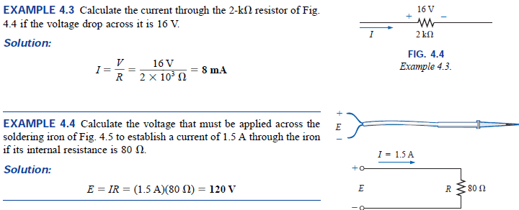
4.1 Example 4.3 /4.4
Abu Ahmed Ferdaus, CSE, DU.

Slide 9
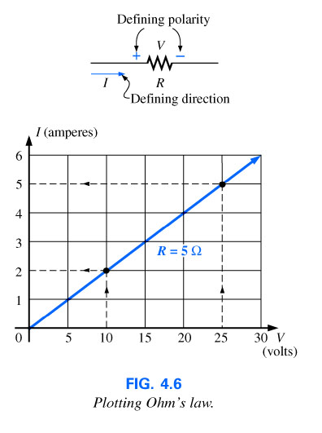
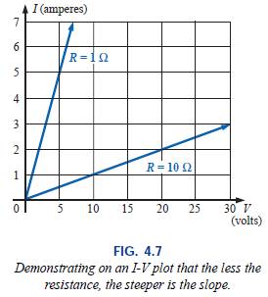
4.2 Plotting Ohms Law
Abu Ahmed Ferdaus, CSE, DU.

Slide 10
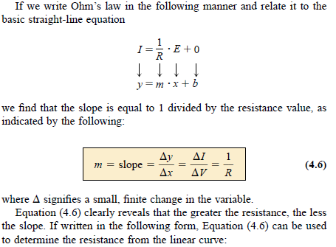
4.2 Plotting Ohms Law
Abu Ahmed Ferdaus, CSE, DU.

Slide 11

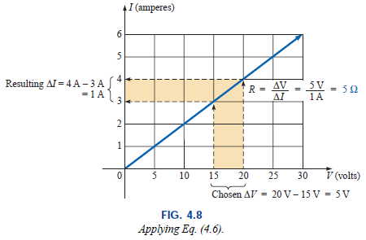
4.2 Plotting Ohms Law
Abu Ahmed Ferdaus, CSE, DU.

Slide 12
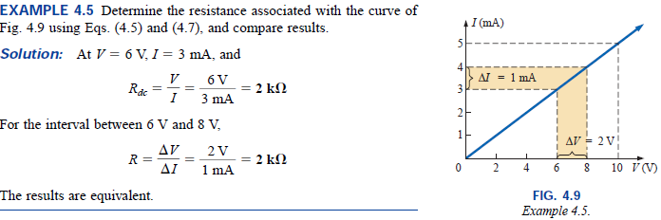
4.2 Example 4.5
Abu Ahmed Ferdaus, CSE, DU.

Slide 13
4.3 Power
Power is an indication of how much work (the conversion of energy from one form to another) can be done in a specified amount of time, that is, a rate of doing work.
A large motor has more power than a small motor because it can convert more electrical energy into mechanical energy in the same period of time.
Since converted energy is measured in joules (J) and time in seconds (s), power is measured in joules/second (J/s).
The electrical unit of measurement for power is the watt (W), defined by:
1 Watt (W) = 1 joule/second (J/s) (4.8)
Abu Ahmed Ferdaus, CSE, DU.

Slide 14

4.3 Power
In equation form, power is determined by
horsepower (hp) is a measure of the average power of a strong dray horse over a full working day. It is approximately 50% more than can be expected from the average horse. The horsepower and watt are related in the following manner:
1 horsepower =746 Watts
Abu Ahmed Ferdaus, CSE, DU.

Slide 15
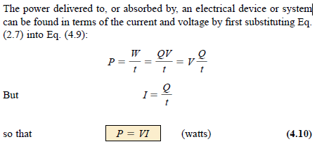
4.3 Power
Abu Ahmed Ferdaus, CSE, DU.

Slide 16
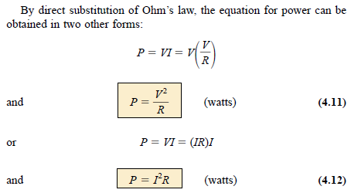
4.3 Power
Abu Ahmed Ferdaus, CSE, DU.

Slide 17
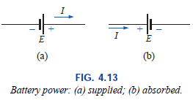
4.3 Power
Power can be delivered or absorbed as defined by the polarity of the voltage and the direction of the current.
For all dc voltage sources, power is being delivered by the source if the current has the direction appearing in Fig. 4.13(a). The current has the same direction as established by the source in a single-source network.
If the current direction and polarity are as shown in Fig. 4.13(b) due to a multisource network, the battery is absorbing power much as when a battery is being charged.
Abu Ahmed Ferdaus, CSE, DU.

Slide 18
4.3 Power
The magnitude of the power delivered or absorbed by a battery is given by
with E the battery terminal voltage and I the current through the source.
Abu Ahmed Ferdaus, CSE, DU.

Slide 19
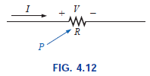
4.3 Power
For resistive elements, all the power delivered is dissipated in the form of heat because the voltage polarity is defined by the current direction (and vice versa).
A reversal of the current direction in Fig. 4.12 will also reverse the polarity of the voltage across the resistor
Abu Ahmed Ferdaus, CSE, DU.

Slide 20
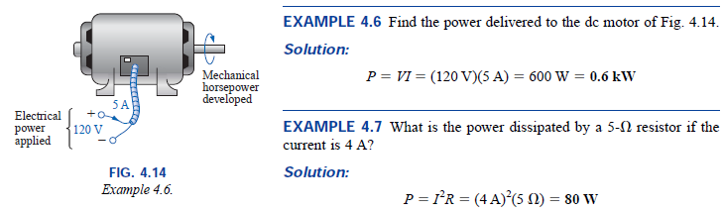
4.3 Power
Abu Ahmed Ferdaus, CSE, DU.

Slide 21
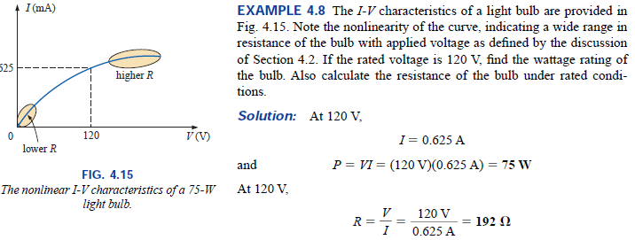
4.3 Power
Abu Ahmed Ferdaus, CSE, DU.

Slide 22
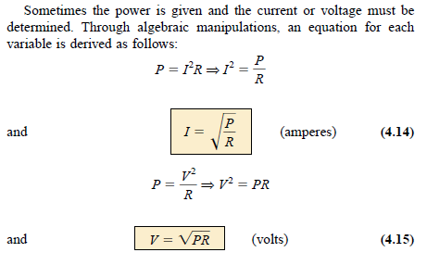
4.3 Power
Abu Ahmed Ferdaus, CSE, DU.

Slide 23

4.3 Example 4.9
Determine the current through a 5-k resistor when the power dissipated by the element is 20 mW.
Abu Ahmed Ferdaus, CSE, DU.

Slide 24
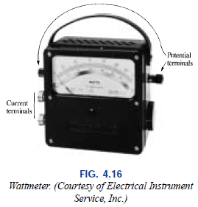
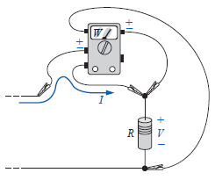
4.4 Wattmeter
An instruments that can measure the power delivered by a source and to a dissipative element. One such instrument, the wattmeter.
Since power is a function of both the current and the voltage levels, four terminals must be connected as shown in to measure the power to the resistor R.
Abu Ahmed Ferdaus, CSE, DU.

Slide 25
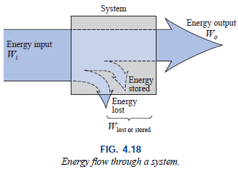

4.5 Efficiency
The output energy level must always be less than the applied energy due to losses and storage within the system.
Conservation of energy requires that
Energy input = energy output + energy lost or stored in the system
Abu Ahmed Ferdaus, CSE, DU.

Slide 26
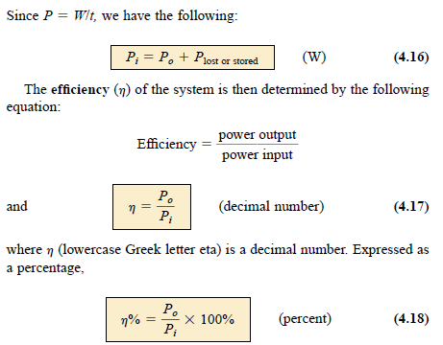
4.5 Efficiency
Abu Ahmed Ferdaus, CSE, DU.

Slide 27
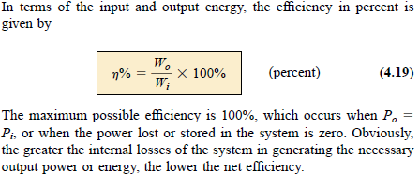
4.5 Efficiency
Abu Ahmed Ferdaus, CSE, DU.

Slide 28
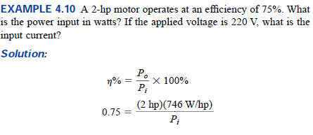
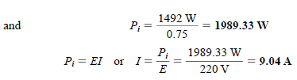
4.5 Example 4.10
Abu Ahmed Ferdaus, CSE, DU.

Slide 29
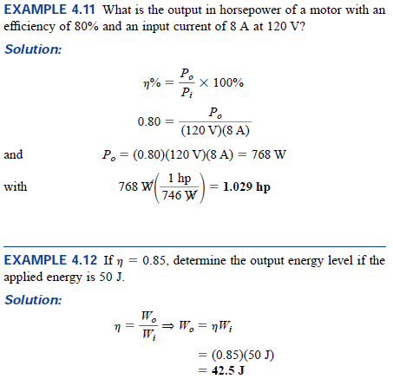
4.5 Example 4.11 / 4.12
Abu Ahmed Ferdaus, CSE, DU.

Slide 30
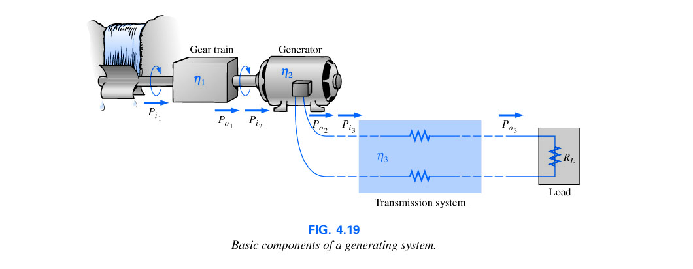
4.5 Efficiency
The basic components of a generating (voltage) system are depicted below, each component has an associated efficiency, resulting in a loss of power through each stage.
Abu Ahmed Ferdaus, CSE, DU.

Slide 31
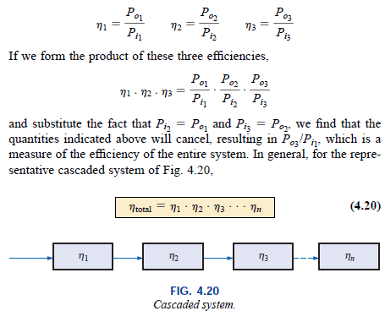
4.5 Efficiency of a Cascading System
Abu Ahmed Ferdaus, CSE, DU.

Slide 32
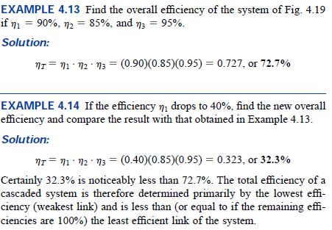
4.5 Example 4.13 / 4.14
Abu Ahmed Ferdaus, CSE, DU.

Slide 33
4.6 Energy
For power, which is the rate of doing work, to produce an energy conversion of any form, it must be used over a period of time. For example, a motor may have the horsepower to run a heavy load, but unless the motor is used over a period of time, there will be no energy conversion.
In addition, the longer the motor is used to drive the load, the greater will be the energy expended.
The energy (W) lost or gained by any system is therefore determined by
Abu Ahmed Ferdaus, CSE, DU.

Slide 34
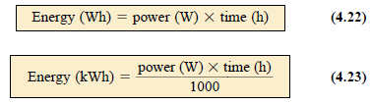
4.6 Energy
Since power is measured in watts (or joules per second) and time in seconds, the unit of energy is the wattsecond or joule as indicated above.
The wattsecond, however, is too small a quantity for most practical purposes, so the watthour (Wh) and kilowatthour (kWh) were defined, as follows:
Abu Ahmed Ferdaus, CSE, DU.

Slide 35
4.6 Energy
The kilowatthour meter is an instrument for measuring the energy supplied to the residential or commercial user of electricity.
It is normally connected directly to the lines at a point just prior to entering the power distribution panel of the building.
Abu Ahmed Ferdaus, CSE, DU.

Slide 36
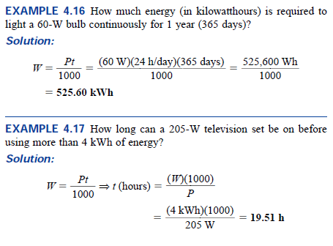
4.3 Example 4.16 / 4.17
Abu Ahmed Ferdaus, CSE, DU.

Slide 37
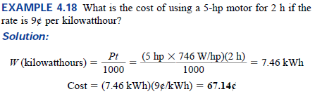
4.6 Example 4.18
Abu Ahmed Ferdaus, CSE, DU.

Slide 38
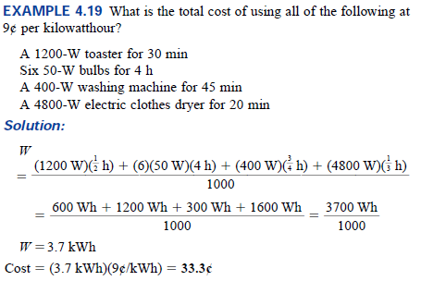
4.6 Example 4.19
Abu Ahmed Ferdaus, CSE, DU.

Slide 39
4.7 Circuit Breaker and Fuses
Power coming into any facility or item must be limited to ensure that the current through the lines or electrical equipment is not above the rated value
Fuses or circuit breakers are installed where the power enters the installation
  Fuses have an internal metallic conductor which begins to melt if the current exceeds the fuse rated value on the case
  In recent years fuses have been replaced with circuit breakers. Circuit breakers have an electromagnet that, when the current exceeds the rated value, has sufficient strength to draw the connecting metallic link out of the circuit and open the path
Abu Ahmed Ferdaus, CSE, DU.

Slide 40
Thank You
Abu Ahmed Ferdaus, CSE, DU.

